Slide 1
ENDECRYPTO - AN ALL IN 1 ENCRYPTION SOFTWARE

Slide 2
Introduction
The requirement for safe data transmission and storage is critical in today's digital world. Encryption and decryption systems are critical in protecting sensitive data from unauthorised access. Our project's goal was to create an encryption-decryption system that could handle any sort of file, regardless of size, and ensure its secure translation.
Traditional file encryptors on the market frequently rely entirely on passwords for encryption, posing a considerable risk to the information' secrecy. If an unauthorised person cracks the password, they will be able to simply decode the encrypted file, jeopardising its security. Recognising this vulnerability, we set out to develop strong encryption-decryption software that goes beyond the constraints of traditional systems.

Slide 3
METHODOLOGY ENCRYPTION PROCESS DECRYPTION PROCESS
Our encryption-decryption software uses advanced algorithms and techniques to secure file transformation. Triple DES-CBC is our primary encryption algorithm, known for its strength and wide adoption in different industries, ensuring a high level of security.
To handle encryption and decryption, we rely on the cryptography library. The Fernet class generates keys and performs symmetric encryption/decryption, guaranteeing secure key management.
For a user-friendly experience, we utilize the Tkinter library to create a graphical interface. This allows users to interact with the software, select files, enter passwords securely, and browse for key files.
Our software addresses the limitations of existing encryption solutions by combining Triple DES-CBC encryption with secure key generation and management. This results in a robust and secure encryption-decryption system capable of handling files of any size and format.

Slide 4
Encryption process
Here are the key steps of our encryption process:
1. The user chooses a file through the graphical interface.
2. A password is required from the user, ensuring it meets a minimum length of 6 characters.
3. Using the Fernet class from the cryptography library, a 256-bit encryption key (Fernet key) is generated. This key is used to encrypt the file contents.
4. An 8-byte random Initialization Vector (IV) is created.
5. The Fernet key is encrypted using the Triple DES-CBC algorithm with the IV and user-provided password. The resulting encrypted key is saved in a separate key file with the ".key" extension.
6. The selected file is read as binary data.
7. The file is divided into chunks, and each chunk is encrypted using the Fernet key.
8. The encrypted file chunks are written to a new file with the ".enc" extension.
9. A message is displayed to the user, confirming the successful encryption and providing the paths to the encrypted file and the key file.

Slide 5
Decryption process
Here are the key steps of our decryption process:
1. The user selects an encrypted file (with the ".enc" extension) using the graphical interface.
2. A password is required from the user, ensuring it meets a minimum length of 6 characters.
3. The user is prompted to choose the corresponding key file (with the ".key" extension) associated with the encrypted file.
4. The key file is decrypted using the Triple DES-CBC algorithm with the IV and user-provided password. The decrypted key is used to decrypt the file contents.
5. The encrypted file is read as binary data.
6. The file is processed in chunks, and each chunk is decrypted using the decrypted key.
7. The decrypted file chunks are written to a new file with the original file extension.
8. A message is displayed to the user, confirming the successful decryption and providing the path to the decrypted file.

Slide 6
SYSTEM DESIGN AND IMPLEMENTATION
Our software follows a client-server architecture with a GUI for user interactions and a server for encryption and decryption. The GUI is created using tkinter library. The encryption engine uses Triple DES-CBC algorithm, and file handling is handled by the File Handler component. Key management encrypts the Fernet key using Triple DES-CBC and stores it in a separate key file. PyInstaller converts the script into a standalone executable for easy distribution.

Slide 7
The software consists of the following components:
1. GUI: Developed using tkinter in Python, it allows users to interact with the software, select files, enter passwords, and initiate encryption or decryption operations.
2. Encryption Engine: Implements Triple DES-CBC algorithm for encryption and decryption. It utilizes the cryptography library in Python for key generation and cryptographic operations.
3. File Handler: Handles file operations, including reading, writing, and manipulation. It efficiently manages large files by dividing them into smaller chunks for encryption and decryption.
4. Key Management: Manages encryption and decryption of the Fernet key. It encrypts the key using Triple DES-CBC with the user-provided password and securely stores it in a separate key file.
5. PyInstaller: Converts the Python script into a standalone executable, making it easy to distribute and install on different platforms.

Slide 8
TESTING AND EVALUATION
We employed the following testing methodologies to ensure software effectiveness and reliability:
1. Unit Testing: Testing individual components and functions.
2. Integration Testing: Testing the integration of software components.
3. Functional Testing: Testing software functionalities for accuracy.
4. Performance Testing: Testing software performance under various scenarios.

Slide 9
TEST SCENARIOS AND DATA SETS
We conducted the following test scenarios to evaluate the software:
1. Encryption and Decryption of Different File Types: Tested encryption and decryption for various file types without data loss or corruption.
2. Handling Large File Sizes: Assessed the software's efficiency in encrypting and decrypting large files without significant impact on processing time or resource utilization.

Slide 10
WEAKNESS AND LIMITATIONS OF THE SOFTWARE
Our software has the following limitations:
1. Increased file size: Encrypted files are larger than the originals due to added encryption data.
2. Limited algorithm options: Currently, only Triple DES encryption is supported, which may not fulfil specific security requirements.
3. Dependency on external libraries: We faced challenges with encryption libraries during development, but selected stable and effective options for our software.

Slide 11

How this project works
Here we took this image file to encrypt

Slide 12
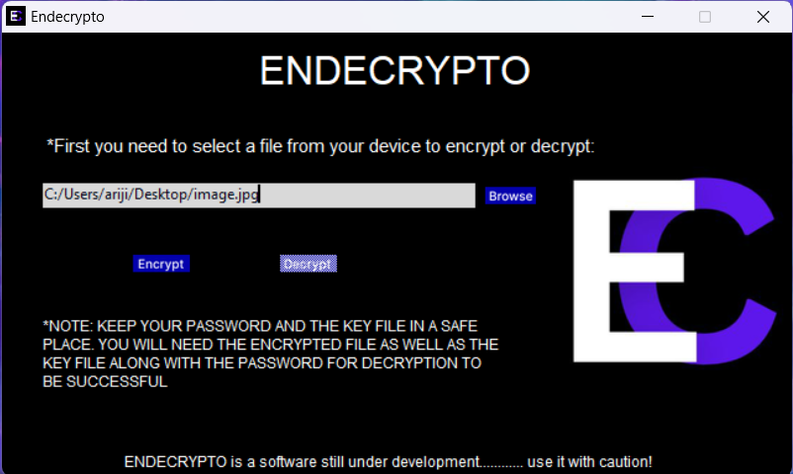
Now put the address of that file in our Endecrypto application

Slide 13
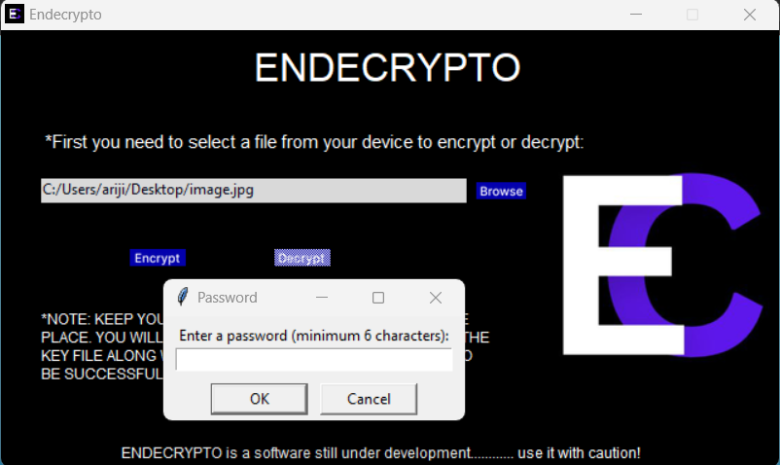
After clicking encrypt it will ask for a password
Now choose a password for minimum six character

Slide 14
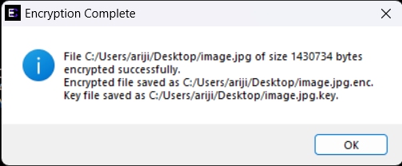
After entering the password your file will saved and also shows where your encrypted file is saved in your device

Slide 15

After encryption your encrypted file will look like this.
This is the process of file encryption, now we see how we decrypt this file

Slide 16
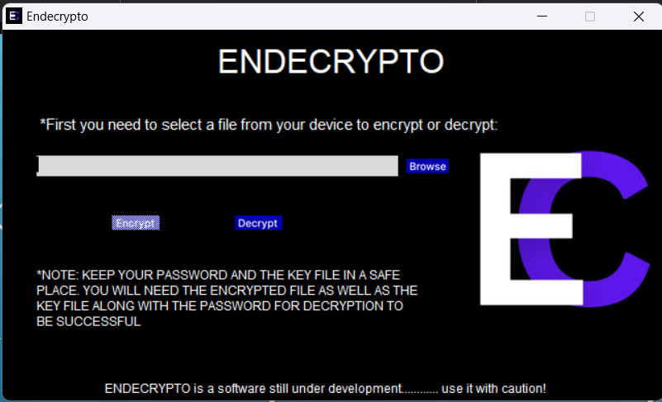
Now jump back to our application

Slide 17
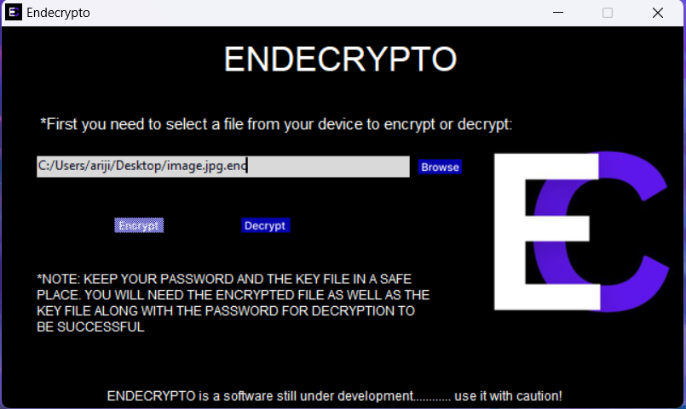
Now enter your encrypted file and click decrypt

Slide 18
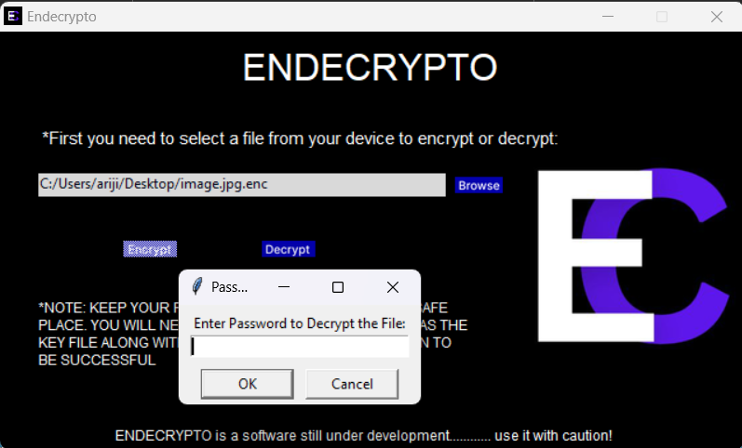
After that it will ask for your password that you have chosen before

Slide 19

Now select your key file that is saved in your device

Slide 20
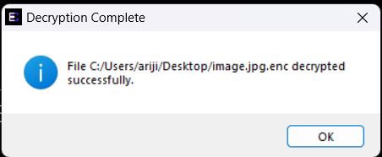
After entering key file it will show that your file is successfully decrypted

